Slide 1






Course project – Maven Analytics
MAVEN MOVIES
ANALYSIS
By = priyanshi

Slide 2



Contents
Defining the Situation
1
Objective
2
The Letter from Purchaser
3
4
Query Resolution(step by step)
Queries and Results
5

Slide 3

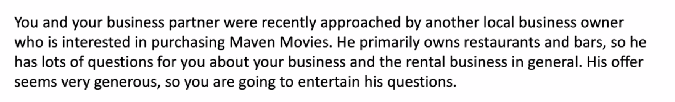
SITUATION

Slide 4




Leverage SQL skills to extract and analyze data from various tables in the Maven movie database to answer the potential acquirer’s questions .
Each question will require to write a multi table SQL query joining at least two table.
Objective

Slide 5



The Letter from Acquirer
Dear Maven movie management,
I am excited about the potential acquisition and learning more about your rental business please beer with me as I am new to the industry . I have number of questions for you assuming you can answer them all and that there are no major surprises we should be able to move forward with the purchase.
best,
Martin Moneybags

Slide 6

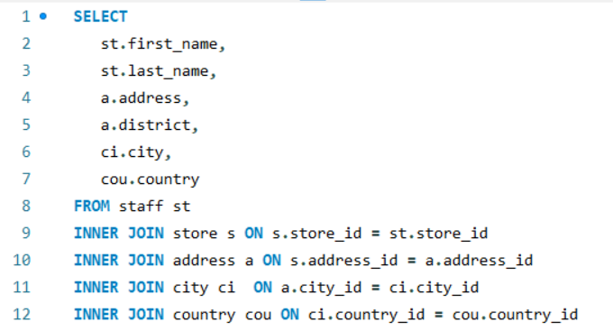

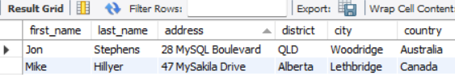
1. Please send over the manager's names at each Store , with the full address of each properties (Street Address ,district , city and country)
The use of INNER JOINs ensures that only matching records across all tables are retrieved, maintaining data accuracy and consistency while providing a complete view of the manager and store addresses.
This query leverages INNER JOINs to establish precise relationships between five tables (staff, store, address, city , country). Each join serves a distinct purpose.

Slide 7


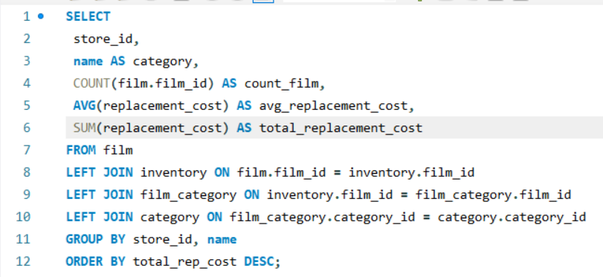
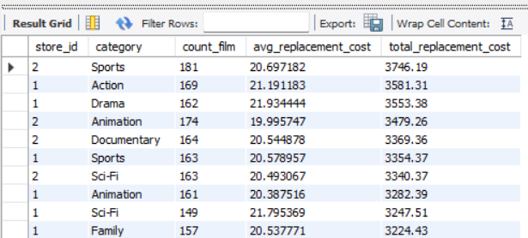
2. We want to see how big of a hit it would be if certain category of film became unpopular at certain store you would like to see the number of films as well as the average replacement cost and the total replacement cost sliced by store and film category.
This ensures that no films are excluded from the results, which is crucial when performing detailed data analysis or generating reports
film → inventory: Ensures all films are included, even if they are not currently in inventory.
inventory → film_category: Links inventory items to their categories, keeping all inventory data.
film_category → category: Retrieves category names, even if some films are not assigned to a category.

Slide 8

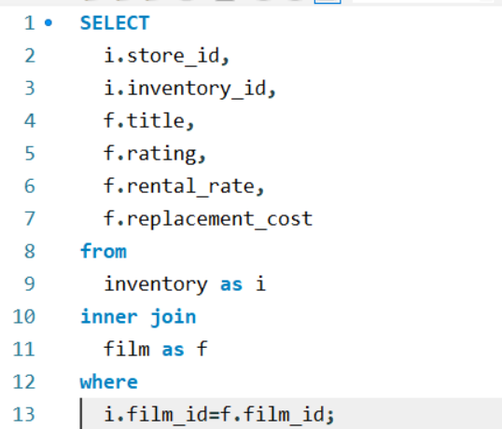
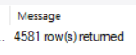
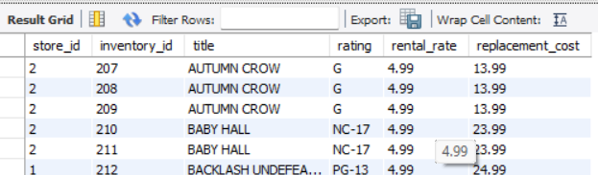

3. Pull together a list of each inventory item you have stocked, including the store ID number , the inventory ID, the name of the film the film's rating , it's rental rate and replacement cost
Specifically, it fetches:
Store ID and Inventory ID for identification,
Film title and rating for customer reference,
Rental rate and replacement cost for business insights.
The INNER JOIN ensures that only inventory items with matching film records are included. The result is a comprehensive dataset of 4,581 inventory records, as shown in the table, highlighting stocked films along with their financial details.

Slide 9
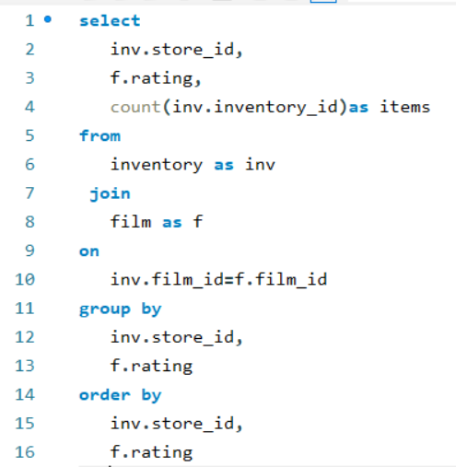

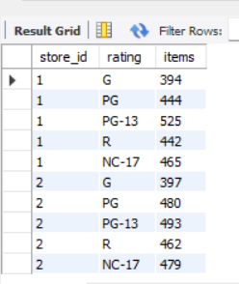
4. Please provide a summary level preview of your inventory we would like to know how many inventory item you have with each rating at each Store
Specifically, it fetches:
Store ID for identification,
Rating from film
By using join it returns the items and its rating matching th records from film table
As a result this query return the count of inventory from the inventory table and its ratings.

Slide 10

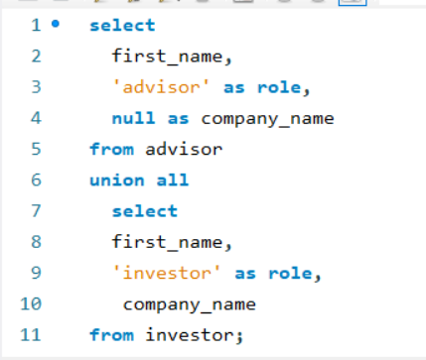
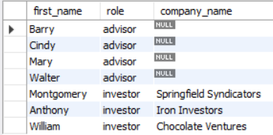
5. Please provide a list of advisor and investor name in one table ? Could you please note whether they are investor or advisor and for the investors, it would be good to include which company they work with ?
UNION in the query combines data from two tables(advisor and investor), selecting matching columns to merge them into a single result set with unique records.
This helped me achieve a unified dataset for analysis.

Slide 11

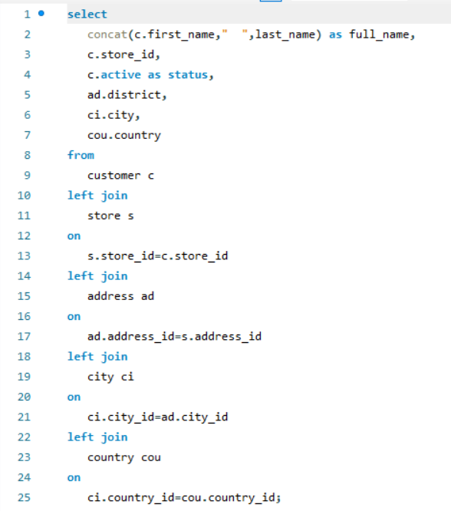

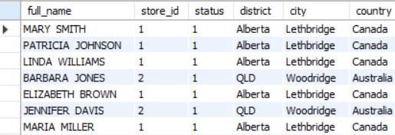
8. Please provide a list of all customer names , which store they go to , whether or not they are currently active, and their full address -street address , city, country ?
Joins the "customers" and "stores" ,”address”,”city”,”country” tables based on the common "store_id" field.
Retrieves store information for each customer, enhancing the query's output.
using LEFT JOIN, retrieving all records matching with conditions applied to filter results.

Slide 12

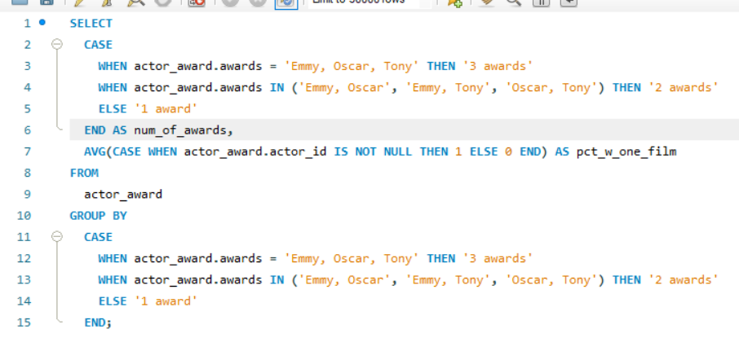
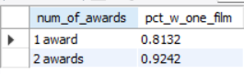
6. How well you have covered the most awarded actors . Of all the actors with three types of awards, for what % of them do we carry a film and how about for actors with two types of awards ,same questions finally how about actors with just one award?
"Utilized CASE statement to determine employee benefits based on awards received”
- if 3 awards received: 3 awards'
- if 2 awards received: 2 awards’
- if 1 awards received : 1 awards'

Slide 13
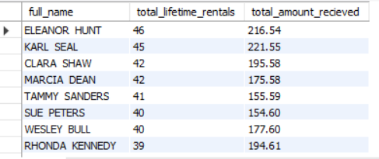
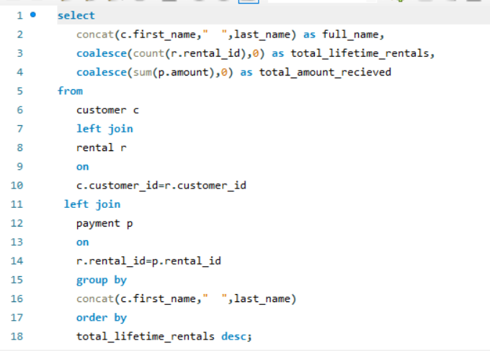
7. Pull together list of customer name, the total lifetime rentals and the sum of all payments you have collected from them , it would be great to see this order on total lifetime value with the most valuable customers at the top of the list.
Used some aggregate functions(sum,count) to calculate the appropriate result
Used COALESCE function to select the first non-null value from a list of columns, ensuring a consistent and reliable output by prioritizing values in a specific order.

Slide 14


THANKS !
I hope you find this meaningful and effective .

